Slide 1
75 Top Hospitality Cases
2025 - 2026
Karen Morris, Esq. and Diana S. Barber, Esq.

Slide 2
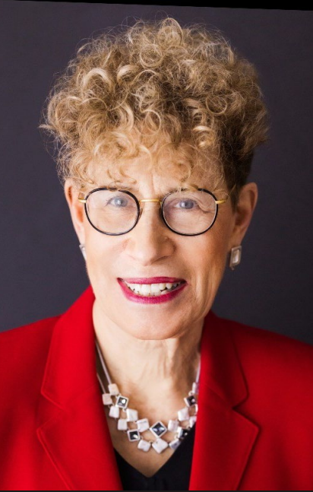
Karen Morris
Municipal Judge, Professor, Lawyer
Author, Hotel, Restaurant and Travel Law: a Preventative Approach
Columnist, Hotel Management Magazine

Slide 3
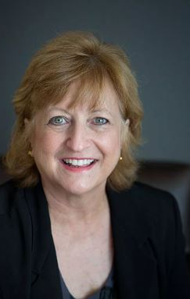
Diana S. Barber
Sr. Lecturer, Georgia State University
Co-Author, Hospitality Law (6th Ed) w/ Stephen Barth
Columnist, Georgia Hotel & Lodging Association

Slide 4
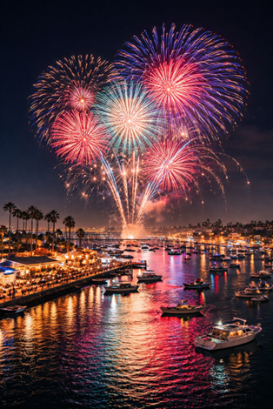
Clean Water Act
Diana
#9 Coastal Environmental Rights Foundation v. Naples Restaurant Group

Slide 5

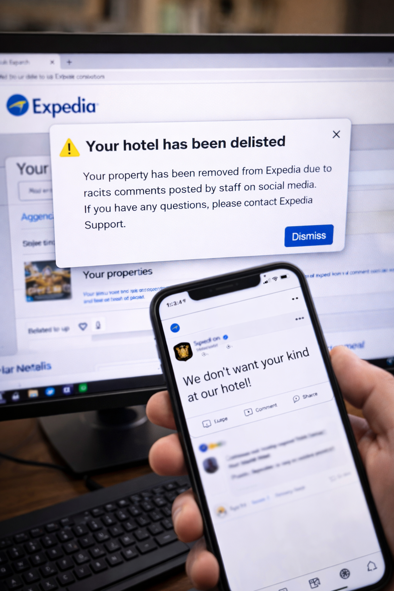
Contracts
Contracts
Karen
#10 Retsel Corp. d/b/a Grand Gateway Hotel v. Expedia, Inc.

Slide 6
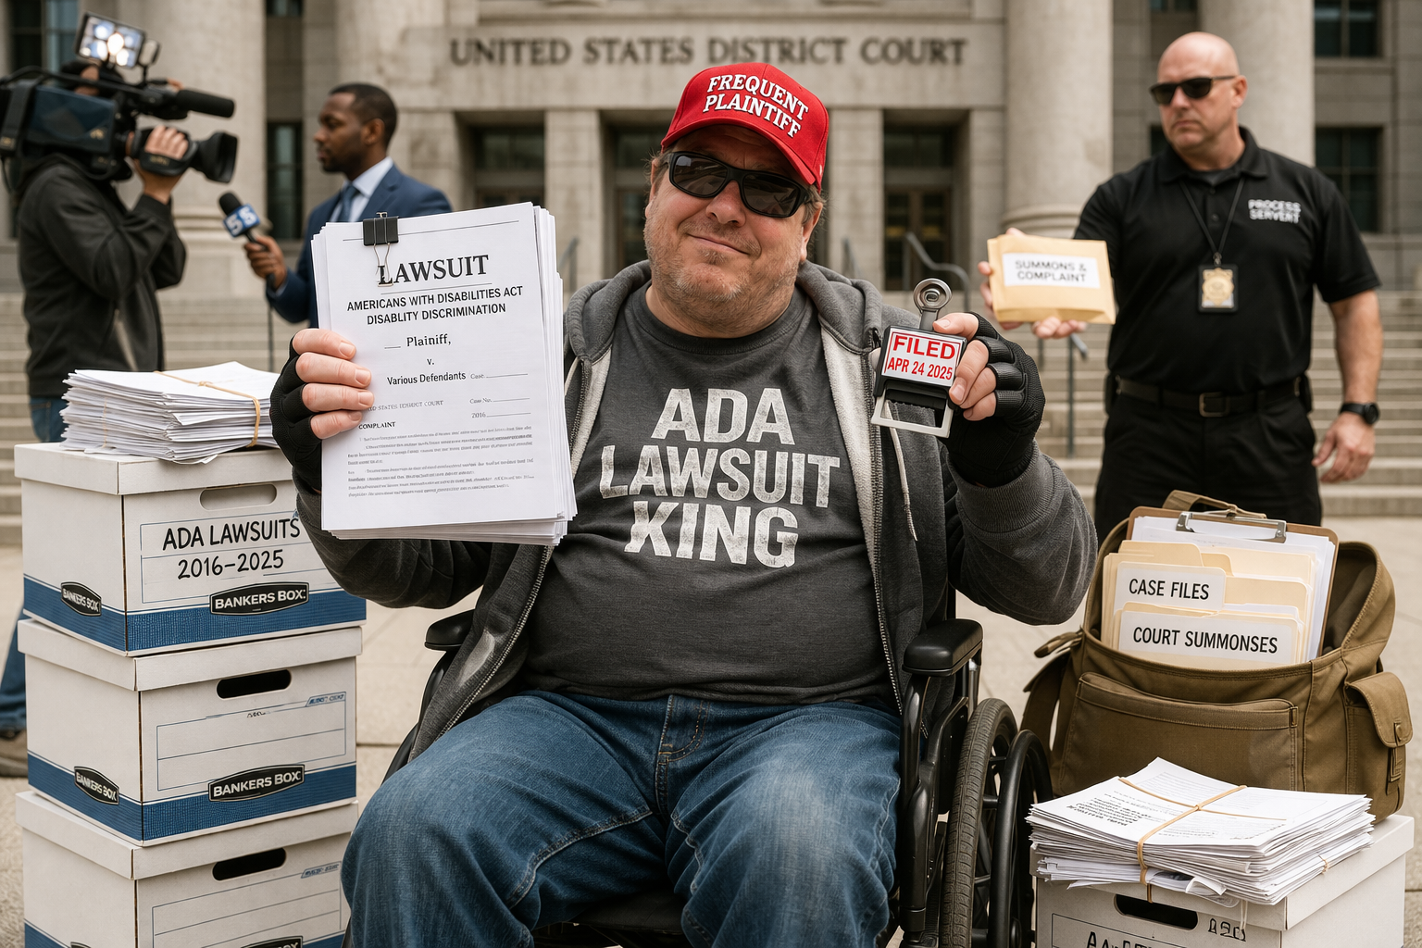
Discrimination in Places of Public Accommodation - Disability
Diana
#15 Gastelum v. CWI2 La Jolla Hotel
#15 Gastelum v. CW12 La Jolla Hotel

Slide 7
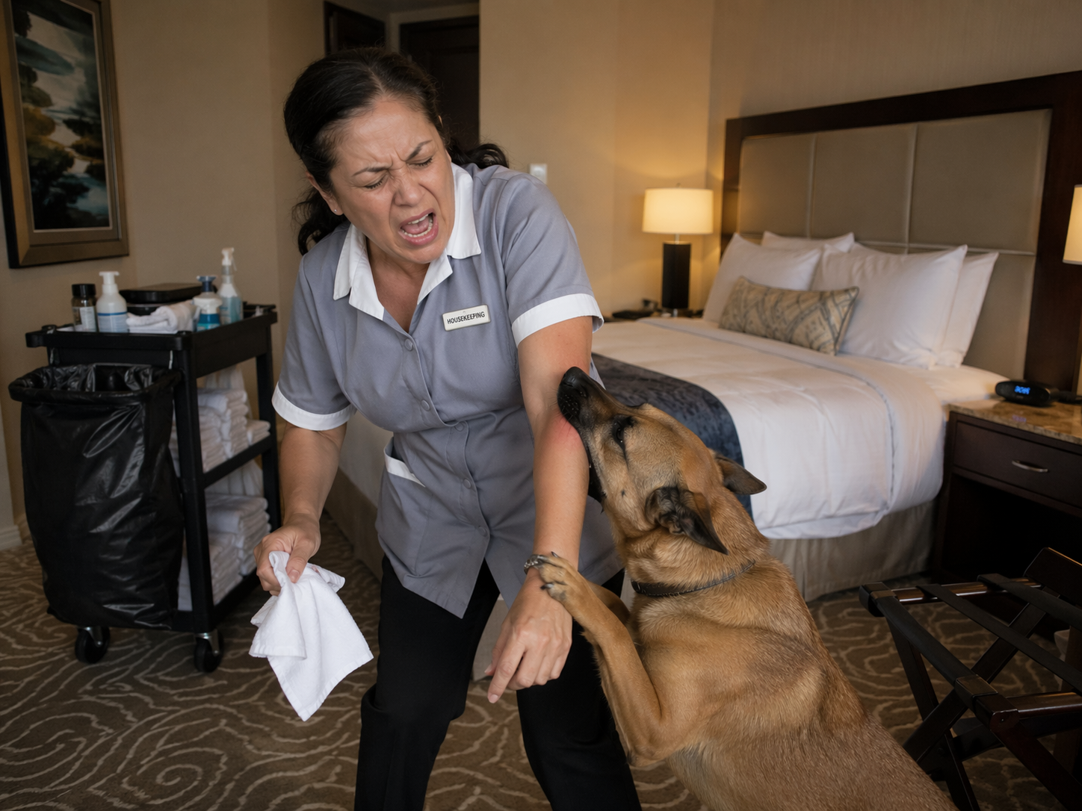
FLSA - Damages
Karen
Exculpatory Clause
#26 Torres v. Risley v. Downtown Grand Hotel and Casino

Slide 8
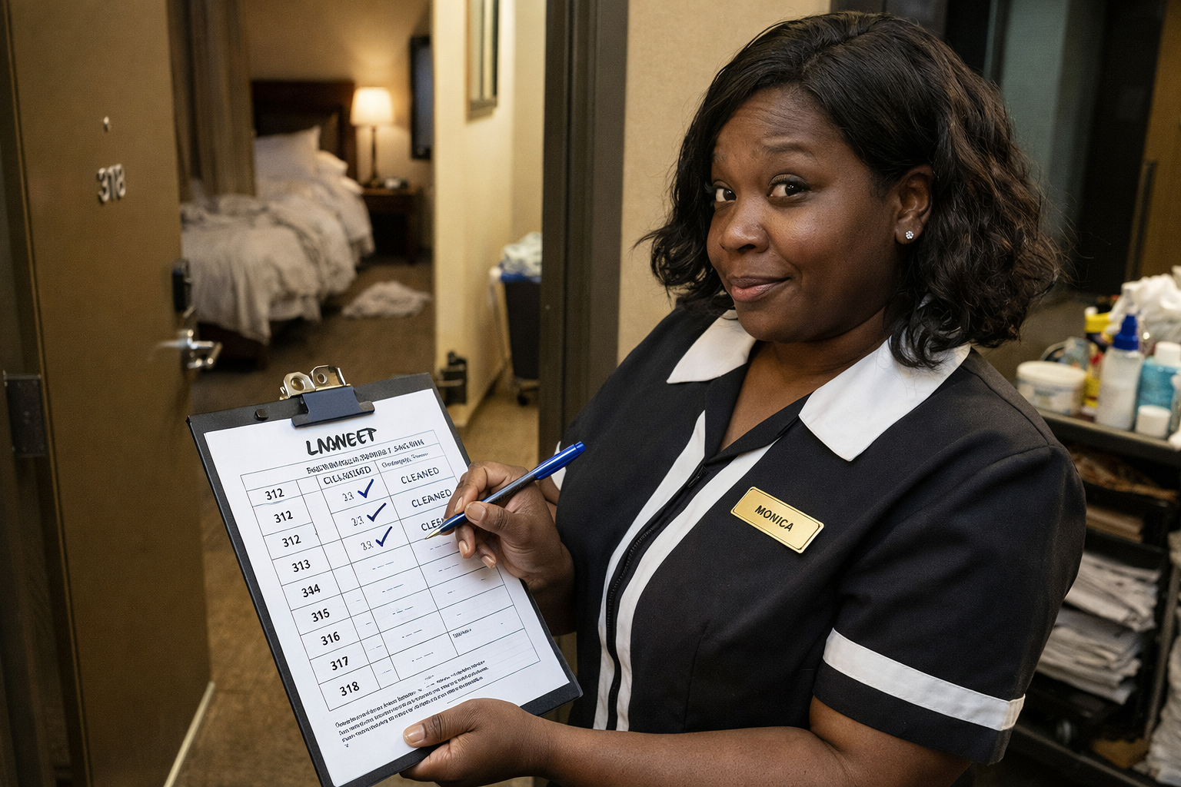
Discrimination in Employment - Race
Diana
#17 Goggins & Lacey v. ALM Printers, LLC d/b/a Hotel Indigo
#17 Goggins & Lacey v. ALM Printers, LLC d/b/a Hotel Indigo

Slide 9

FLSA - Damages
Karen
Fair Labor Standards Act - Damages
#30 Paschal v. Perry’s Restaurants

Slide 10
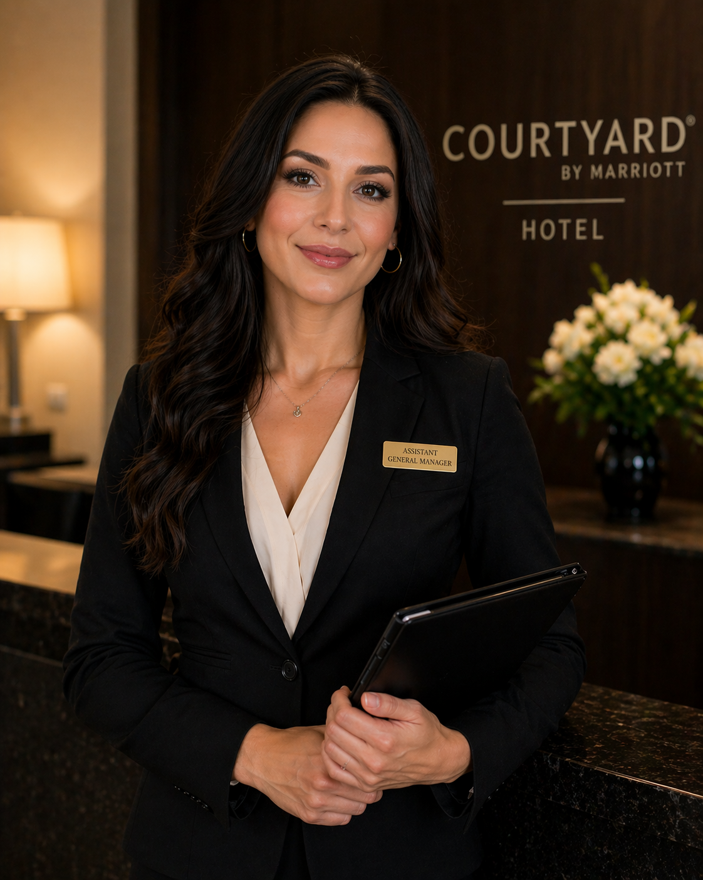
Employment – Discrimination LGBTQ+
Diana
#18 Fendel v. Shreeji Hotel Group, LLC and
Hotel Equities, LLC

Slide 11
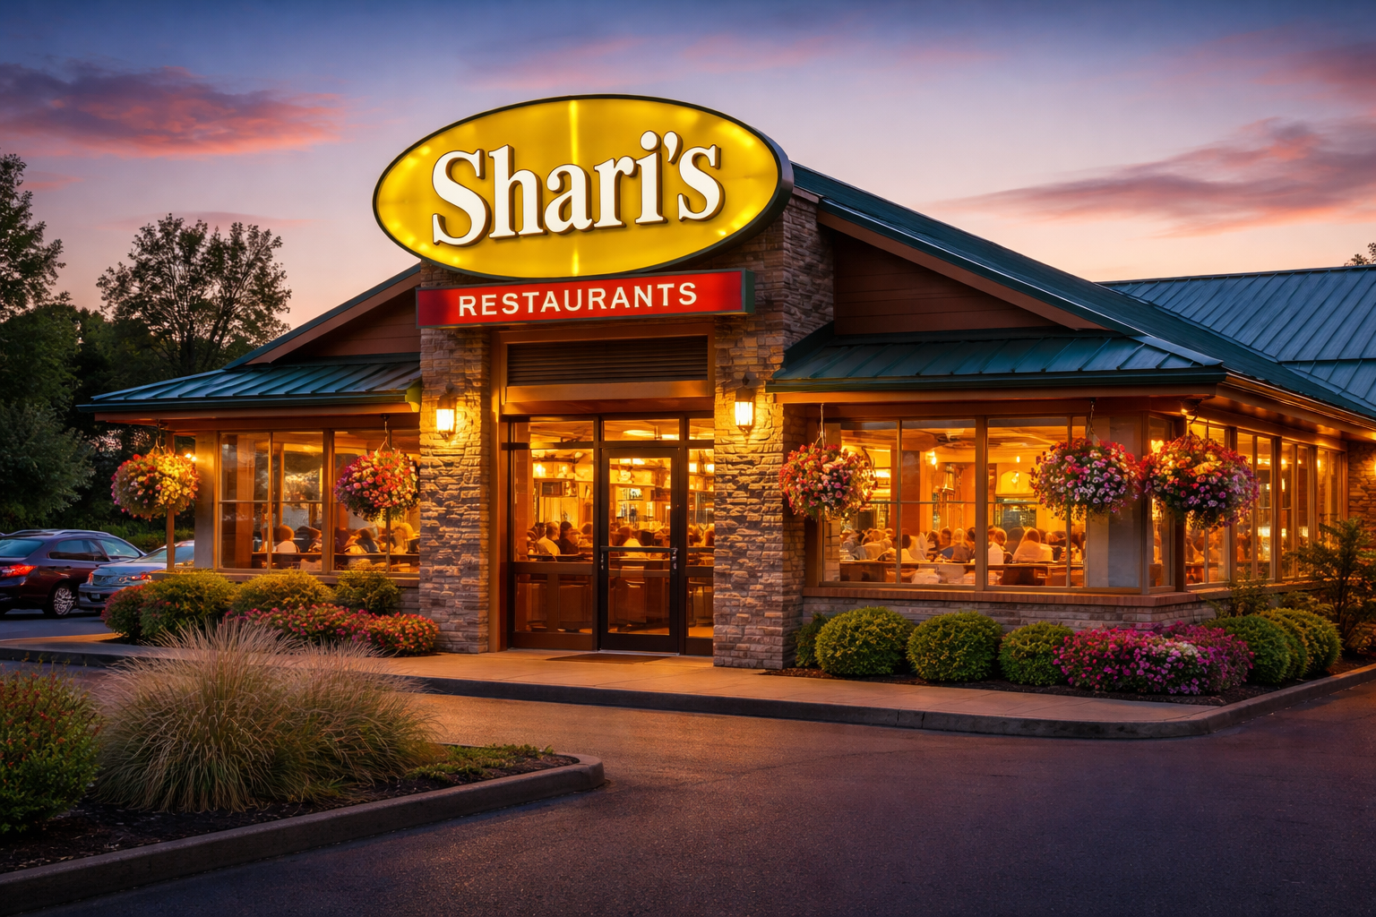
Fiduciary Duty Breached
Fiduciary Duty Breach
Karen
#34 MGG SPV Duck LP v. Shari’s Restaurant Group

Slide 12
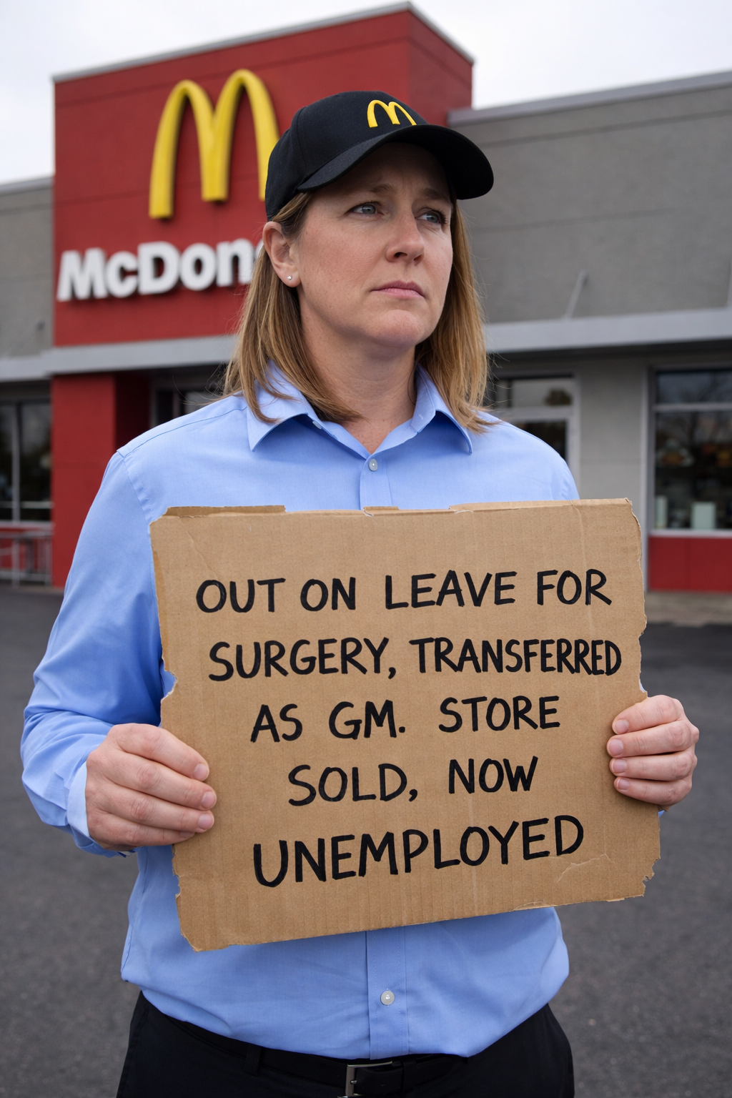
Employment – Discrimination Disability
Diana
#21 Johnson v. McDonald’s Restaurants of Ohio
#21 Johnson v. McDonald’s Rest. Of Ohio

Slide 13
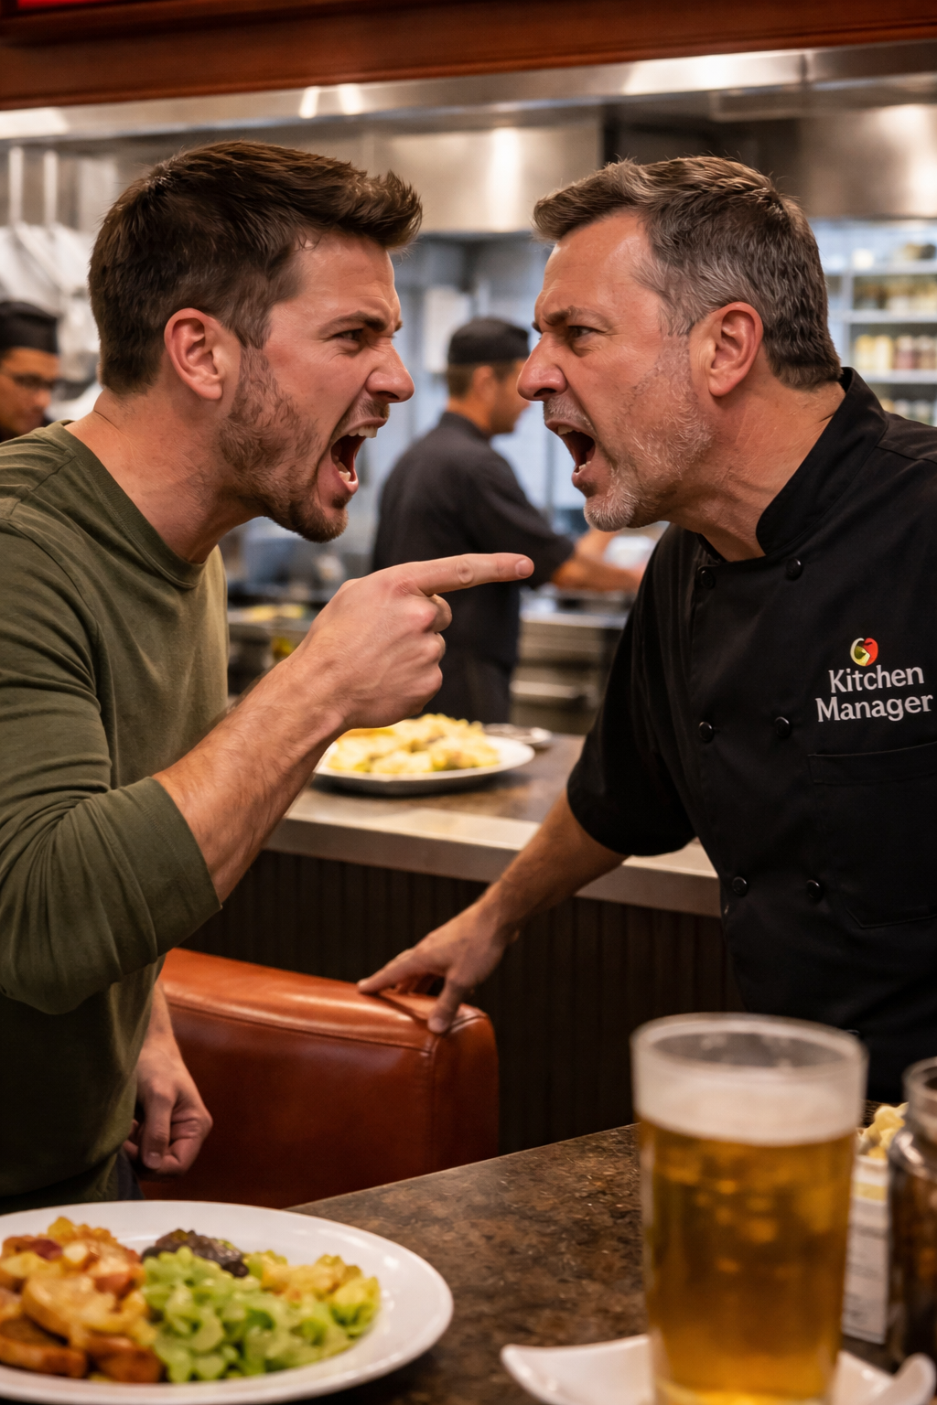
Franchisor Liability
Franchisor Liability
Karen
#38 Arefin v. Doherty Group, Inc.

Slide 14
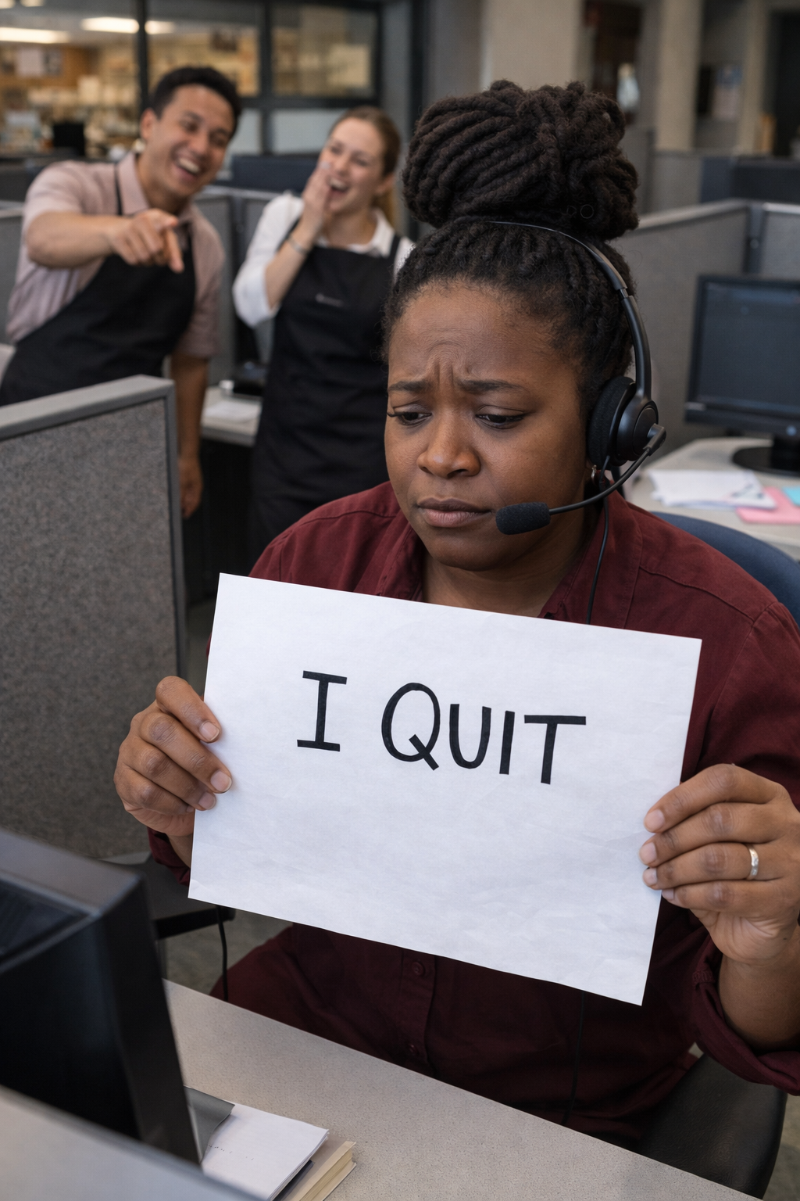
Employment-Discrimination-Race
Diana
#23 Gore-Reed v. Blue Ribbon Restaurants
Novi, LLC
#23 Gore-Reed v. Blue Ribbon Restaurant Novi, LLC

Slide 15

Insurance
Karen
Insurance
#44 Lerner v. The Perch Hotel

Slide 16

Employment – Discrimination
Sexual Harassment
Diana
#25 Walker v. MG Oil Co., d/b/a The Park Restaurant

Slide 17
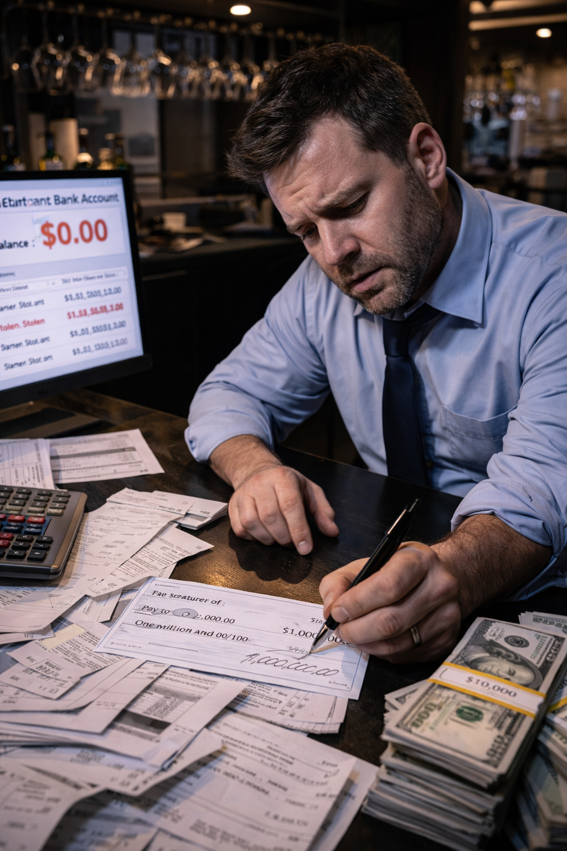
Insurance Contract Interpretation
Insurance Contract Interpretation
Karen
#45 Raymond’s Restaurant Corp. v. Travelers Indemnity Co.

Slide 18
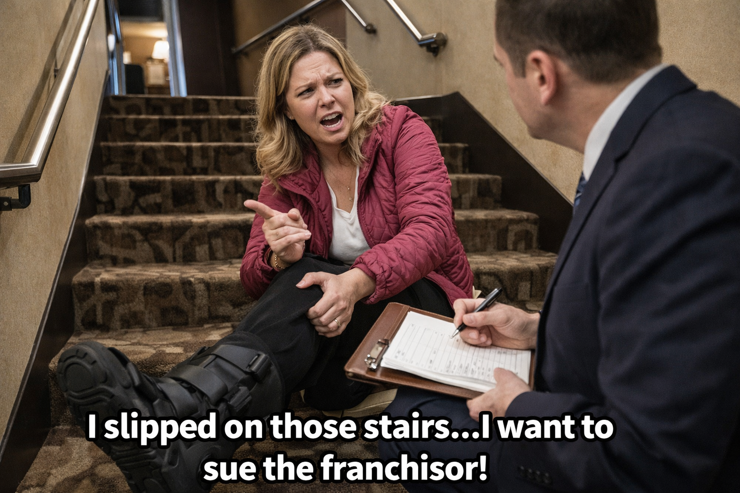
Franchisor Liability
Diana
#37 Ingle v. Sonesta International Hotels
#37 Ingle v. Sonesta International Hotels

Slide 19
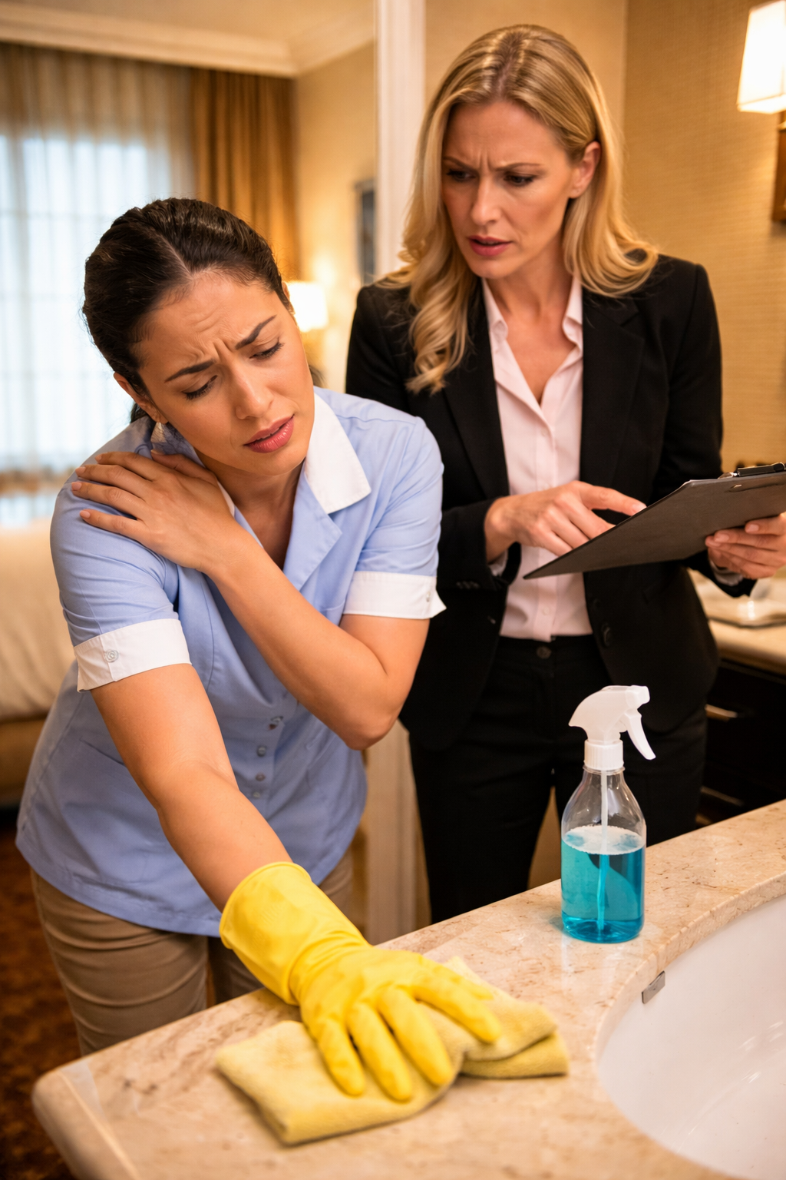
Intentional Infliction of
Intentional Infliction of Emotional Distress
Karen
#47 Ferizovic v. Hilton Hotels Rosemont

Slide 20
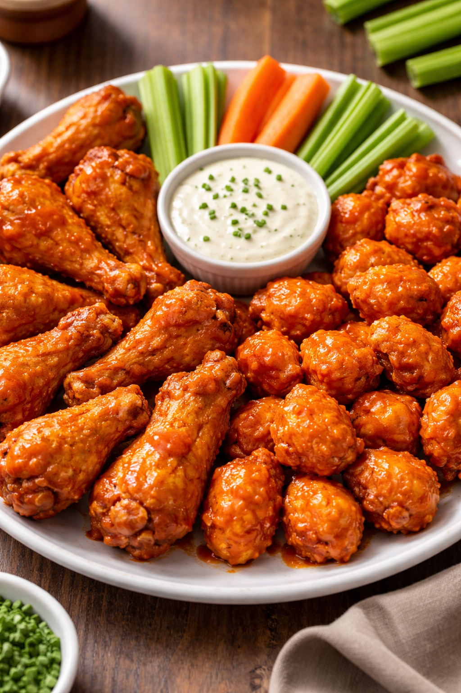
Judicial Notice
Diana
#48 Halim v. Buffalo Wild Wings, Inc.

Slide 21
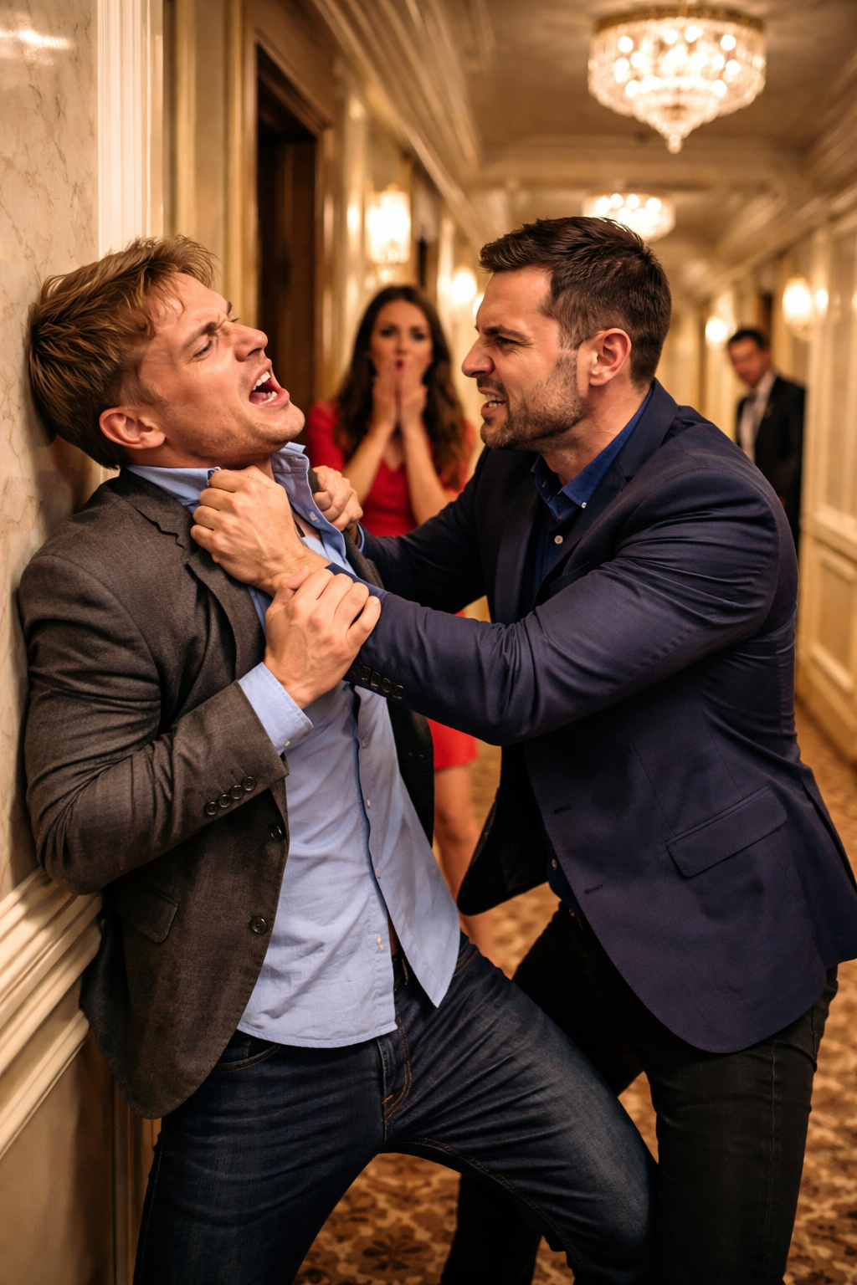
Negligent Hiring
Karen
Negligent Hiring
#54 Lemoine v. W. Bank Hotel, LLC

Slide 22

Liquor License Application
Diana
#49 Lechiara v. Wooton
# 49 Lechia v. Wooton

Slide 23
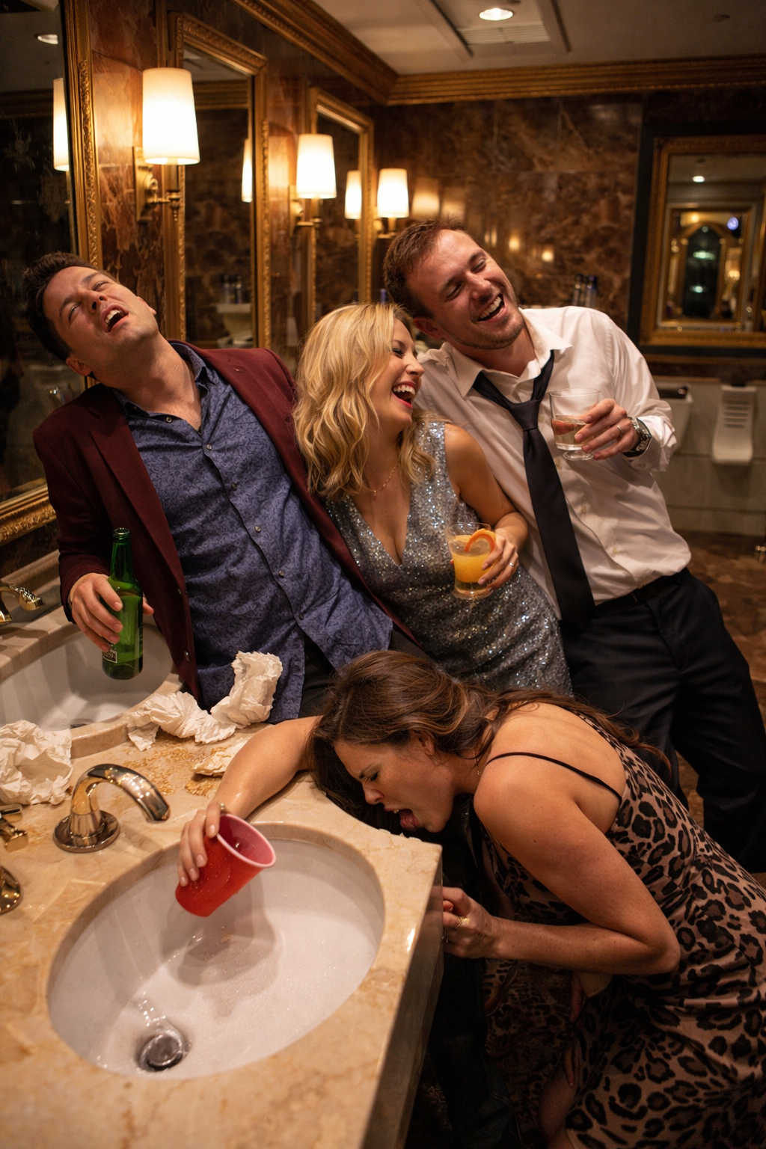
Negligence - Security
Negligence - Security
Karen
#59 Jackson v. Live! Casino and Hotel Philadelphia

Slide 24
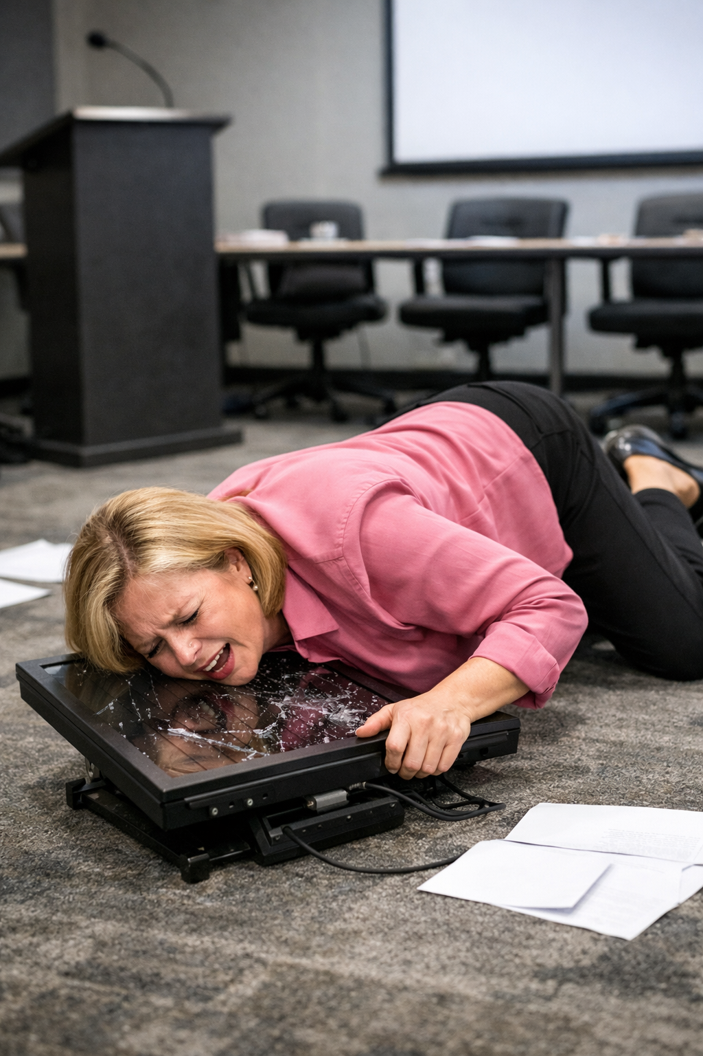
Negligence
Diana
#51 Bruce v. Aurora Convention Center
Hotel Lessee
# 51 Bruce v. Aurora Convention Center Hotel Lessee

Slide 25
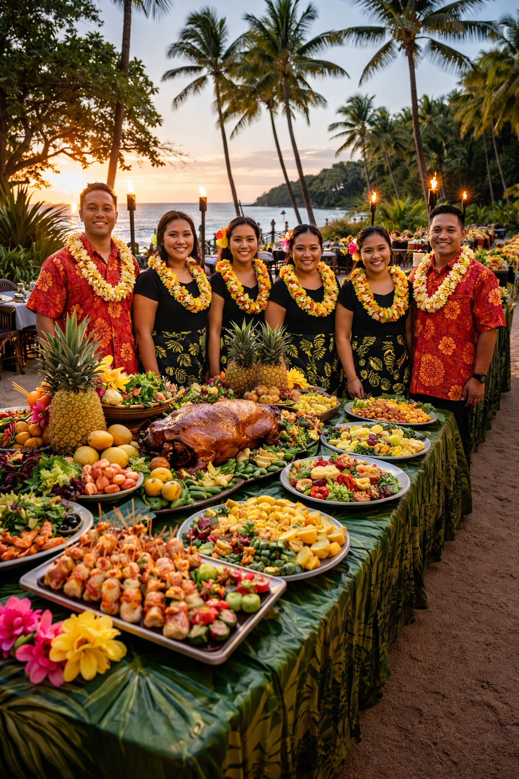
Service Charge
Service Charge
Karen
#65 Rodriguez v. Mauna Kea Resort

Slide 26

Diana & Karen

